Slide 1


CAPSTONE PROJECT 2 DEFENSE
Software Engineering & Management Information System
Danang, Jun 2021

Slide 2

Capstone Project II
EXPERT-DRIVEN SMART DASHBOARD APPLICATION
Team: C2SE-06
Mentor:
PhD Binh Nguyen Thanh
MSc Huy Truong Dinh
Capstone project I
SMART DASHBOARD APPLICATION
Team: C1SE-06
Mentor:
PhD Binh Nguyen Thanh
MSc Huy Truong Dinh
Notes:
Hoa
Good morning and thanks everyone for being here today. Today we are going to report on the capstone project 2. Our group topic is: Expert Driven Smart Dashboard Application.
This is an extended version of SDA, aimed at helping professor in many fields quickly and easily analyze and visualize, supporting to create reports on their own data sources.
Xin chào thầy cô và các bạn, hôm nay tụi e sẽ báo cáo về đồ án capstone 1. Đề tài nhóm đó là: Smart Dashboard Application.
Xây dựng 1 trang web phân tích và trực quan hoá các dữ liệu về môi trường ở Việt Nam như: Khí Hậu, Dân Số, Rừng, Nền công nghiệp.
A Collaborative Web-Based Environmental Data Visualization and Analysis Framework in Vietnam.

Slide 3





Team C2SE-06
Name: Binh Thanh Nguyen
Role: Mentor
Contact: ttb_2001@yahoo.com
International School at Duy Tan University
Name: Huy Truong Dinh
Role: Mentor
Contact: huy.truongdinh@gmail.com
International School at Duy Tan University
Name: Hoa Vo Van
Role: Scrum Master / Developer
Contact: hoavo.dng@gmail.com
Class: K23 CMU TPM1
Team Lead at FPT Software
Name: Tin Pham Van
Role: Designer / Developer
Contact: tinphamvan123@gmail.com
Class: K23 CMU TPM1
mgm technology partners vietnam
Name: Dong Ky Huu
Role: Developer
Contact: kyhuudong@gmail.com
Class: K23 CMU TPM6
mgm technology partners vietnam
Name: Kieu Tran Thi Thanh
Role: Secretary / Developer
Contact: thanhkieutran391@gmail.com
Class: K23 CMU TTT
S.T United
Notes:
Kieu
Participating in this project are :
mentor : teacher Nguyen Thanh Binh and teacher Truong Dinh Huy
scrum master:
developer:

Slide 4
Table of contents
Main content:
1. Idea
2. Product
3. Technologies Stack
4. Project Management
5. Summary
6. Demo
7. Reflection
Idea
Application
Technologies Stack
Our Product
Notes:
Kieu
These are the main contents that will be presented
Đây là những nội dung chính sẽ được trình bày trong buổi báo cáo này :

Slide 5
Idea
Notes:
Kieu
Firstly, we will introduce an overview of the idea that prompted us to launch this project.
Trước tiên, chúng em sẽ giới thiệu tổng quan về ý tưởng đã thôi thúc chúng em khởi động dự án này

Slide 6

Table of contents
Main content:
1. Idea
2. Product
3. Technologies Stack
4. Project Management
5. Demo
6. Reflection
7. Summary
From
Smart Dashboard Application
Project
SDA is the forerunner of EDSDA, a system that helps environmental experts analyze environmental data in Vietnam.
Notes:
Hoa
EDSDA is inspired by Smart Dashboard Application, a system that visualizes environmental data in Vietnam, which is also the Capstone 1 topic of our team last semester.
After receiving feedback from teachers and users, we found that SDA has many limitations such as the data source still depends on administrators, the processes are not fully automated, the manipulation is not yet optimized for users.
So that, we decided to upgrade the Smart Dashboard Application to be an "Expert-Driven" smart dashboard, to make EDSDA relevant and usable for all users without no longer dependent on the system's available data sources.
With more tools and automated processes, we want EDSDA to become not only a place for data analysts to do their jobs, but also an open data hub, where data is stored to help all users easily find and manipulate the data source they want.

Slide 7
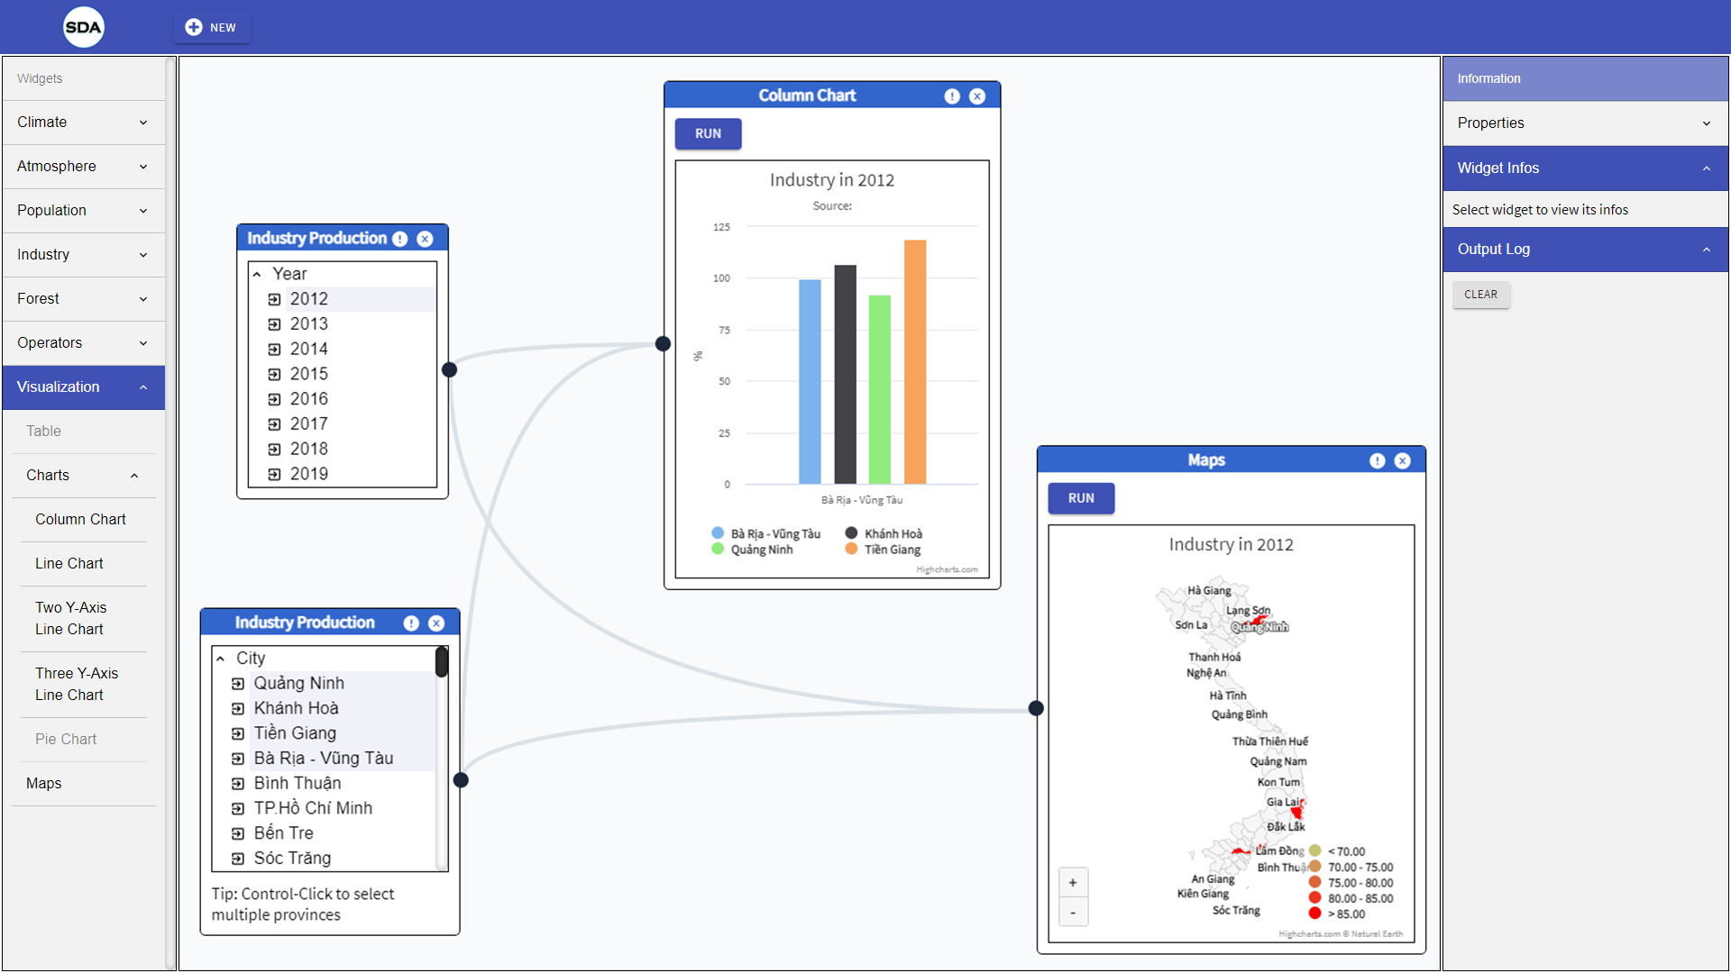
Idea
Notes:
Kieu
Firstly, we will introduce an overview of the idea that prompted us to launch this project.
Trước tiên, chúng em sẽ giới thiệu tổng quan về ý tưởng đã thôi thúc chúng em khởi động dự án này

Slide 8
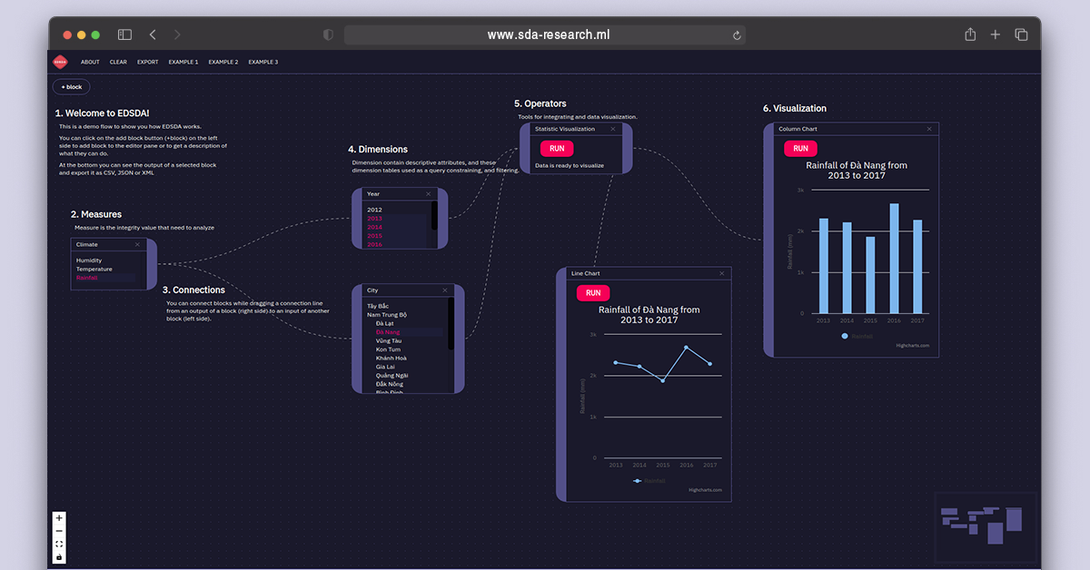
Idea
Notes:
Kieu
Firstly, we will introduce an overview of the idea that prompted us to launch this project.
Trước tiên, chúng em sẽ giới thiệu tổng quan về ý tưởng đã thôi thúc chúng em khởi động dự án này

Slide 9


Table of contents
Main content:
1. Idea
2. Product
3. Technologies Stack
4. Project Management
5. Demo
6. Reflection
7. Summary
From Smart Dashboard Application Project
SDA is the forerunner of EDSDA, a system that helps environmental experts analyze environmental data in Vietnam.
Expand target users
Desire to expand the audience of users, not only environmental experts, but also become a system for all those who need to analyze and visualize data quickly and conveniently.
Expanding the topic of data and tools, become an open data hub
Expect the system to handle all topics of data, providing more useful tools for data analysts. In addition, EDSDA can become a sharing data hub for everyone.
Notes:
Hoa
EDSDA is inspired by Smart Dashboard Application, a system that visualizes environmental data in Vietnam, which is also the Capstone 1 topic of our team last semester.
After receiving feedback from teachers and users, we found that SDA has many limitations such as the data source still depends on administrators, the processes are not fully automated, the manipulation is not yet optimized for users.
So that, we decided to upgrade the Smart Dashboard Application to be an "Expert-Driven" smart dashboard, to make EDSDA relevant and usable for all users without no longer dependent on the system's available data sources.
With more tools and automated processes, we want EDSDA to become not only a place for data analysts to do their jobs, but also an open data hub, where data is stored to help all users easily find and manipulate the data source they want.

Slide 10

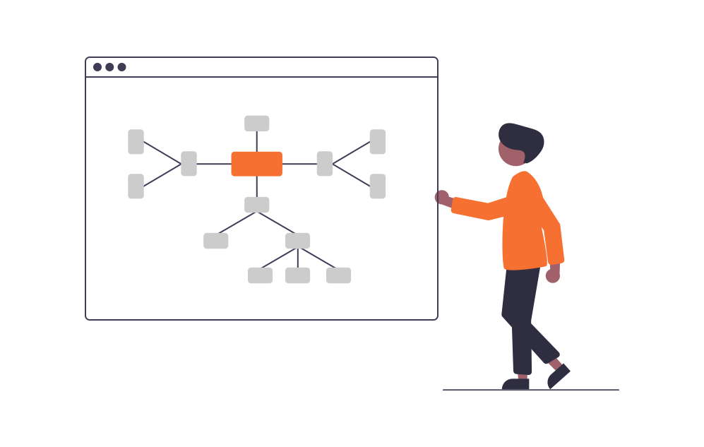
TARGET USER
For all users with data analysis and visualization needs, regardless of industry or data subject
MAKE IT EASY
Notes:
EDSDA is not only aimed at experts in a certain field, our system is aimed at becoming a data visualization and analysis tool for everyone without any special skills.

Slide 11
Product
Notes:
Dong

Slide 12
Table of contents
Main content:
1. Idea
2. Product
3. Technologies Stack
4. Project Management
5. Demo
6. Reflection
7. Summary
Goal
What we have done
Architecture
Context Diagram
Scope & Data warehouse Design
Data workflow and automating data pipeline
RDF Data Cube Structure
RDF DATA CUBES AUTO GENERATOR
Module View (Server)
Component & Connector
Module View (Client)
Challenges & Future scopes
Notes:
Kieu
In this part, i’ll talk about our tasks goal and what we have done in capstone project 2

Slide 13

GOAL
1. Climate
1. Data Sources Importing
2. Auto ETL Processing
3. Smart Data Cubes Suggestion
4. Data Visualized Exporting
5. Smart - Friendly - Modern UI
6. Open Data Sharing Hub
Notes:
The goal of the project is to build an automatic data storage and processing system, including sub-flows such as: data source importing, Auto ETL Processing, Smart Data Cubes Suggestion, Data Visualized Exporting. In addition, we aim to build a Smart - Friendly - Modern User interface to make it easy for all users to use, so that EDSDA can become a true open data hub.

Slide 14

Architecture & Design
Notes:
Hoa

Slide 15
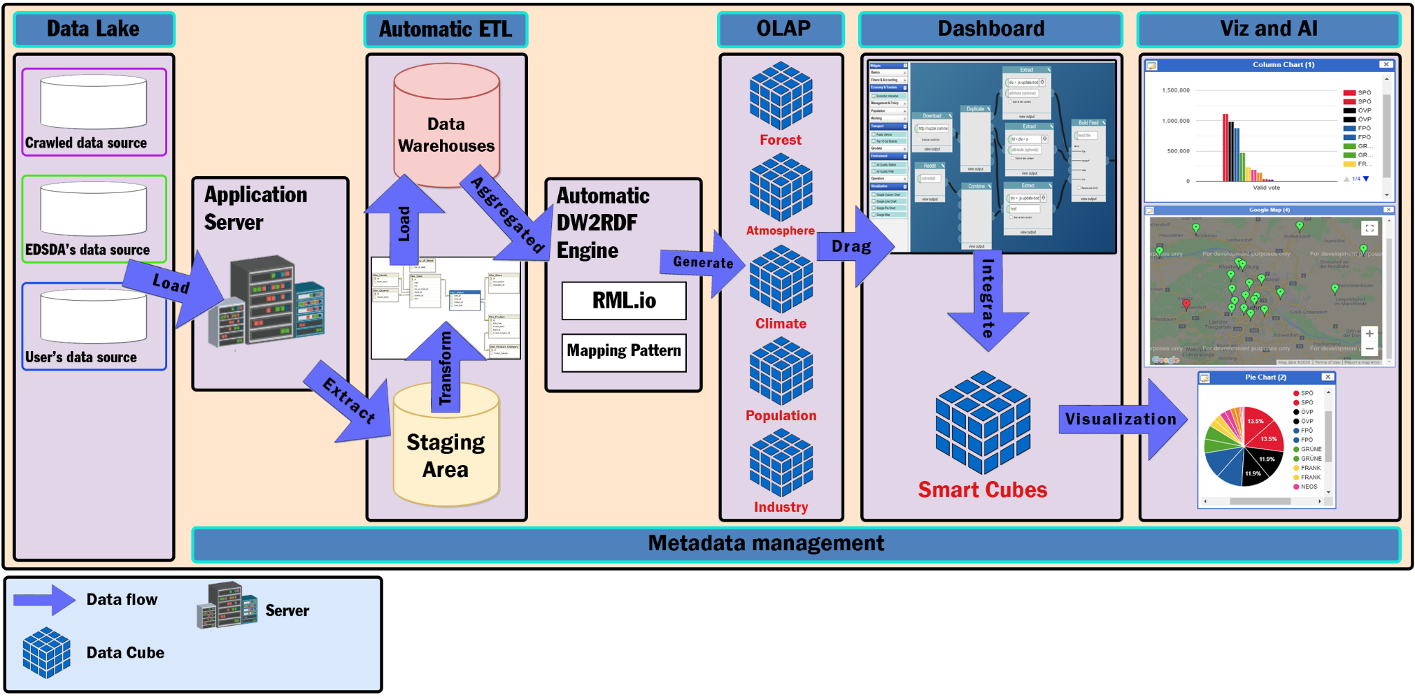
Table of contents
Main content:
1. Idea
2. Product
3. Technologies Stack
4. Project Management
5. Demo
6. Reflection
7. Summary
Context Diagram
Notes:
Hoa
To solve the data problem, we have preliminary designed the system with the following main modules:
Data Lake:
Collect from environment open data platforms of the governments and NGO,, User imported data sources.
We Use web crawling techniques to crawl data from some goverments websites.
then the application server will
Application Server:
Check for the changes of the data lake when the user imports new data sources.
Handle Data Lake Exceptions if any errors occur.
Trigger the Data Lake to Staging Area loading process.
after triggering the loading process, the data source will come through the
Automatic ETL (Extract, Transform, Load)
In this step, we extract structured data after restructuring the raw data from the data lake. Mainly in this step, we focus on exacting data correctly from the structured data from the data lake.
Based on the business’s constraints we have to transform the data to be compatible with our process to handle the data for displaying on the dashboard. Getting exacted data, transforming the data, and ready to load into the DW.
The last step is Loading data into the target data warehouse. We load all the data we have transformed into the staging areas of DW and based on the data we have loaded into staging areas we used to load the data from the staging areas to dimension tables, and fact tables.
Automatic DW2RDF Engine:
Using RML.io with our custom features, it can generate RDF Data cubes automatically when users import new data sources to the data warehouse.
Suitable with all data sources with a general mapping method.
OLAP
In this step, we store the data of the data warehouse as OLAP cubes. And then, for better query performance, data binding, and scalability, in addition to information transparency, we will automate converting OLAP cubes into RDF Data Cubes.
Dashboard
In this step, the user can drag any data cubes that appear as items on the toolbox and drop them onto the main content board, then connect between them and use the operator such as statistics merge, geo merge to build a new data cube that matches the user requirement.
Viz & Filter & Sort
This step will perform the data cube which was created by the user with the form they want. It can be a map, a column chart, a line chart, or a pie chart.

Slide 16
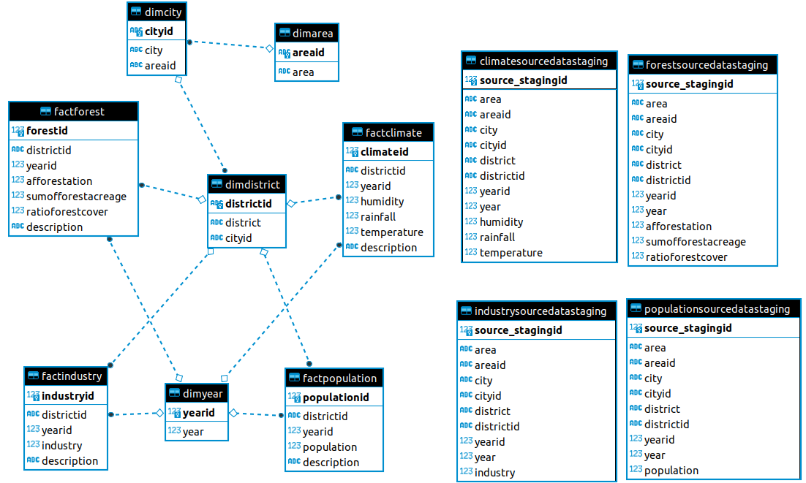
Table of contents
Main content:
1. Idea
2. Product
3. Technologies Stack
4. Project Management
5. Demo
6. Reflection
7. Summary
SCOPE & DATA WAREHOUSES DESIGN
Notes:
Dong
In this part i ll talk about the DW design
In this new version we have updated new dataware house design with the galaxy schema
The DW now having a HIERARCHY structure
We have three main important things called: fact table, dimension table, and staging area.
So.
The fact tables contain the measures, and foreign keys which refer to primary keys in the dimension tables.
Dimension tables contain descriptive attributes, and these dimension tables used as a query constraining, and filtering.
And Staging area is for validation, remove constraints of the data types for data process, and data integrity.
Galaxy Schema in Data Warehouse modeling
Just because it has
-A simple relational model with a one-to-many relationship between each dimension tables and the fact tables.
-It’s easy to understand
-it makes our queries more simpler, by using JOIN queries more easier
-Scalability, we can expand more dimensions, and measurable properties to each fact tables for diversification visualized on our dashboard.
This is all for the DW design.

Slide 17
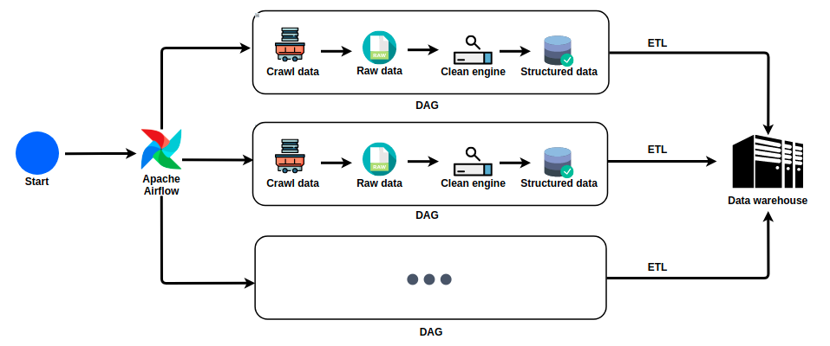
Table of contents
Main content:
1. Idea
2. Product
3. Technologies Stack
4. Project Management
5. Demo
6. Reflection
7. Summary
Automating ETL process
Data pipeline workflow with Apache Airflow managing DAGS
Notes:
Automating the ETL process
In this part I ll talk about how we perform the ETL process automatically.
We use apache airflow to managed our workflow, data pipeline.
This is the big picture of whole Data Work -> Apache Airflow manage all the DAGs . if you concern what is the Dag so ? Dag is stand for Directed acyclic graph. The Graph contains workflow and data pipeline.
The apache airflow controll each dag to perform the workflow to load data into the DW

Slide 18
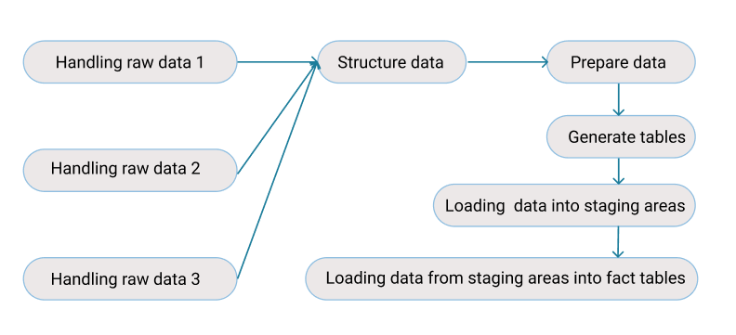
Table of contents
Main content:
1. Idea
2. Product
3. Technologies Stack
4. Project Management
5. Demo
6. Reflection
7. Summary
Data workflow and automating data pipeline
Data workflow
Notes:
Behind the scene
Deep down into detail of the DAG
This is a base workflow dag
We have this dag to show the dataflow from the start to finish . each task of the dag we can reusable . At the start we handling the raw data to structure data , and then we enrich data based on our bussines and load all data into the DW

Slide 19
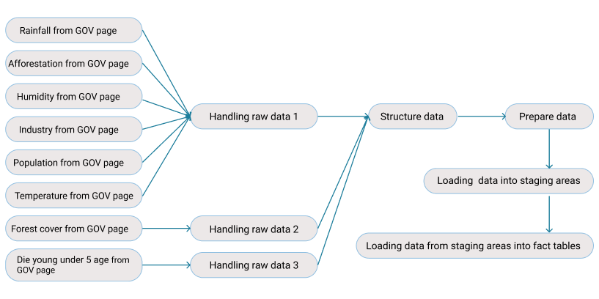
Table of contents
Main content:
1. Idea
2. Product
3. Technologies Stack
4. Project Management
5. Demo
6. Reflection
7. Summary
Data workflow and automating data pipeline
Automating ETL workflow
Notes:
In this dag: data sources is crawled from government pages automatically.
Each data we crawled having a different structure so we have split it into compatible handling raw data engine
After all, all the raw data become structure data, and using ETL process for enrich the data, after the data is ready we going to load the data into the DW.
This is the overall data workflow, we also can split it into smaller tasks, but to give you guys a overview so we combine the task into a big picture.

Slide 20
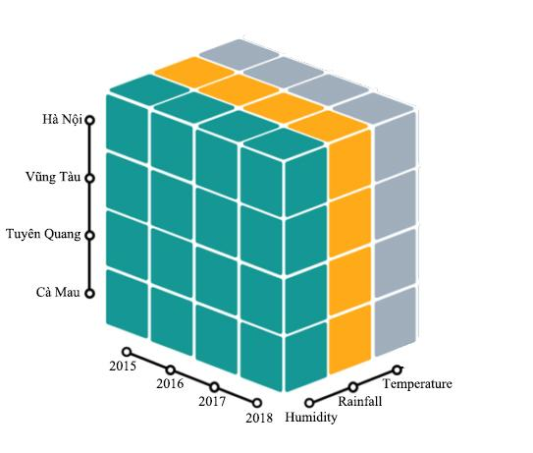
Table of contents
Main content:
1. Idea
2. Product
3. Technologies Stack
4. Project Management
5. Demo
6. Reflection
7. Summary
RDF DATA CUBE STRUCTURE
Climate Data Cube
Notes:
Dong After all the workflow is done The first key to deciding on the entire project architecture is the basic structural design of the rdf data cube.
Why we choose to build rdf data cubes? it allows us to integrate, compare and divide between datasets.
An example of a data block in edsda,
Climate data block includes including 2 dim and 3 measures
2 dim including year and city
The 3 measure includes Humidity, Rainfall, Temperature
So
The multidimensional data block has a strong point: being able to simply access the dataset with any dimension of the datacube,
For example the user can get data on humidity for any province, for any year, or data on humidity for a year and for a certain province.
Mấu chốt đầu tiên quyết định đến toàn bộ kiến trúc dự án là thiết kế cơ bản cấu trúc của rdf data cube.
Vì sao lựa chọn xây dựng các rdf data cube? nó cho phép chúng tôi tích hợp, so sánh và phân chia giữa các tập dữ liệu.
Ví dụ về 1 khối dữ liệu trong sda, Khối dữ liệu về khí hậu bao gồm 3 chiều, trong đó có 2 dim và 3 measure 2 dim bao gồm year and city 3 measure bao gồm… Khối dữ liệu nhiều chiều có thế mạnh : có thể truy cập được đến dataset với một chiều dữ liệu bất kì một cách đơn giản, Ví dụ người dùng có thể lấy dữ liệu về độ ẩm tại một tỉnh bất kì, tại một năm bất kì, hoặc dữ liệu độ ẩm của 1 năm tại 1 tỉnh nhất định

Slide 21
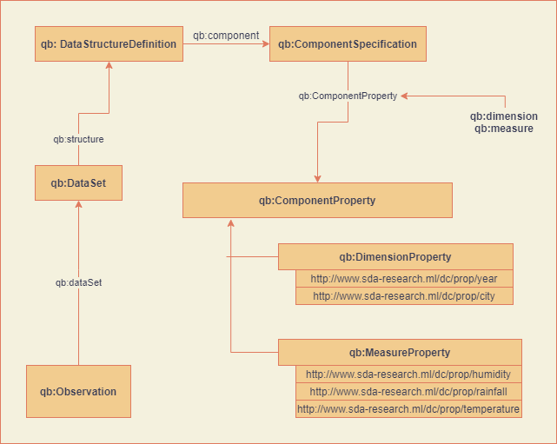
Table of contents
Main content:
1. Idea
2. Product
3. Technologies Stack
4. Project Management
5. Demo
6. Reflection
7. Summary
RDF DATA CUBE STRUCTURE
Climate Data Cube
Notes:
Dong
The rdf data cube is defined based on the w3c group rdf data cube vocabulary
As you can see, each dimension and each measure in the rdf climate data cube is represented by a URI, which allows us to query those data dimensions with just the URI without going through any database, this is what makes the rdf data cube powerful, which no other database system can do yet

Slide 22
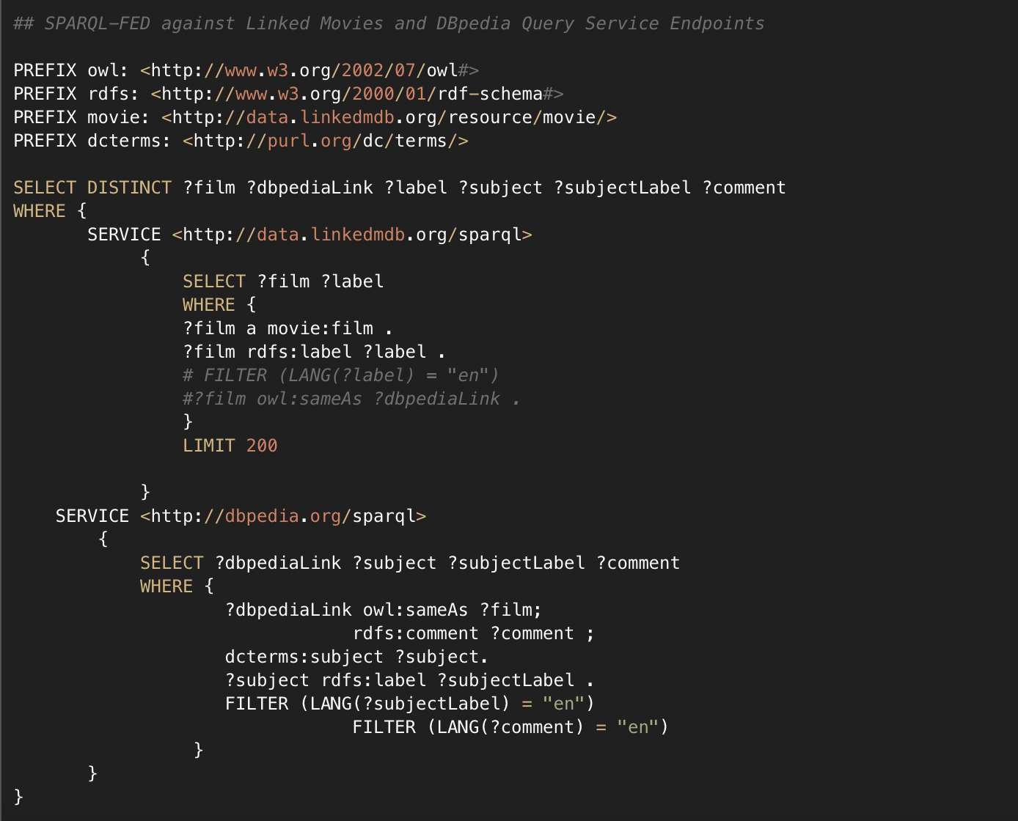
Table of contents
Main content:
1. Idea
2. Product
3. Technologies Stack
4. Project Management
5. Demo
6. Reflection
7. Summary
RDF DATA CUBE STRUCTURE
SPARQL Query
Notes:
Dong
To query the RDF Data cube, we use the SPARQL language to perform queries on linked data sets. As the illustration, to link the properties of a movie, we do not need to be granted permission to access database of those two websites above to get data, but just need to merge these data sets through the provided URIs.
After this Hoa will talk about how to automatically generating the RDF data cubes

Slide 23
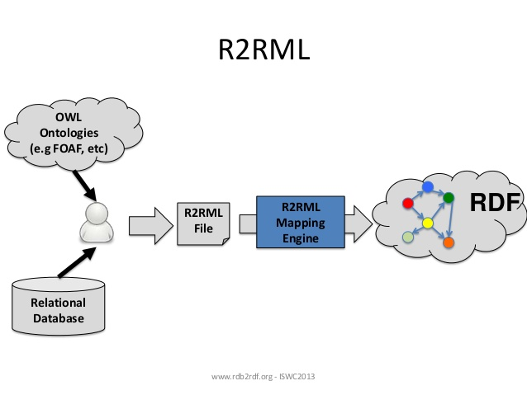
Table of contents
Main content:
1. Idea
2. Product
3. Technologies Stack
4. Project Management
5. Demo
6. Reflection
7. Summary
RDF DATA CUBES AUTO GENERATOR
Data flow of Manual Relational Database to RDF process.
Notes:
Hoa
but, the most challenging thing we faced, is how to automatically convert data sets from data warehouse to rdf data cube format?
With traditional methods, we will use r2rml mapping language to model data from relational database to linked data set. However this is only done manually every time a new dataset is updated by defining a new structure data mapping file

Slide 24
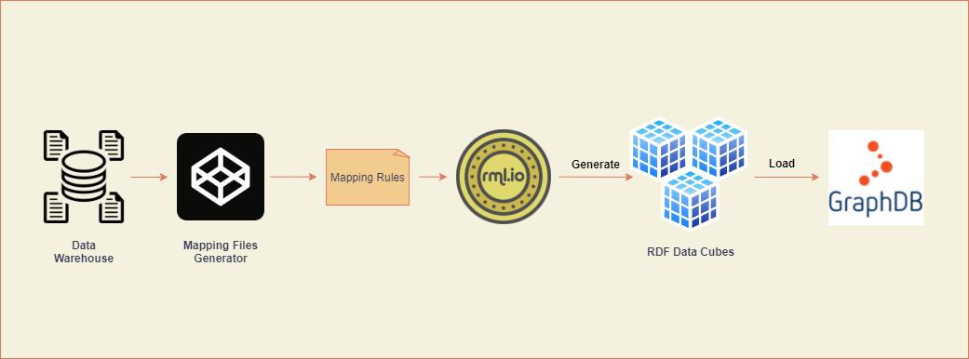
Table of contents
Main content:
1. Idea
2. Product
3. Technologies Stack
4. Project Management
5. Demo
6. Reflection
7. Summary
RDF DATA CUBES AUTO GENERATOR
Data flow of Automatic RDF Data Cubes Generator
Notes:
Hoa
For EDSDA, a system where data is scraped continuously and allows users to upload their primary data source to the system, it is not appropriate to use traditional R2RML methods. Therefore, we have researched and implemented an automatic conversion method from Relational Database and Tabular Data to RDF Data Cubes
As illustrated for the process above, the basic EDSDA RDF Data Cubes Generator will have 6 main parts:
Data Warehouse: At first, data will be loaded manually from the data warehouse. Then, every time users upload new data sources, the system will check if the data warehouse is updated and start getting the new data source from it.
Mapping Files Generator: After a new data source is obtained, the Mapping Files Generator will be launched. In the first version, it will handle the cases where the fact table has 1,2 or 3 measures and dimensions. Names of the fact table, measures, and dimensions will be assigned as variables in the R2RML mapping language.
Mapping Rules: Mapping Files generated from Mapping Files Generator.
RML.io: To execute the process of generating RDF Data Cubes from Mapping Rules and data sources, we use the RMLMapper and RMLStreamer frameworks provided by the RML.io organization. They are platforms that help users produce high quality linked data and knowledge graphs that are fast and easy to install.
RDF Data Cubes that are generated from the previous parts.
OntoText GraphDB: RDF data blocks will be uploaded to the Ontotext GraphDB datastore through the API to respond to data requests from the server and publicize open linked data to end users.

Slide 25
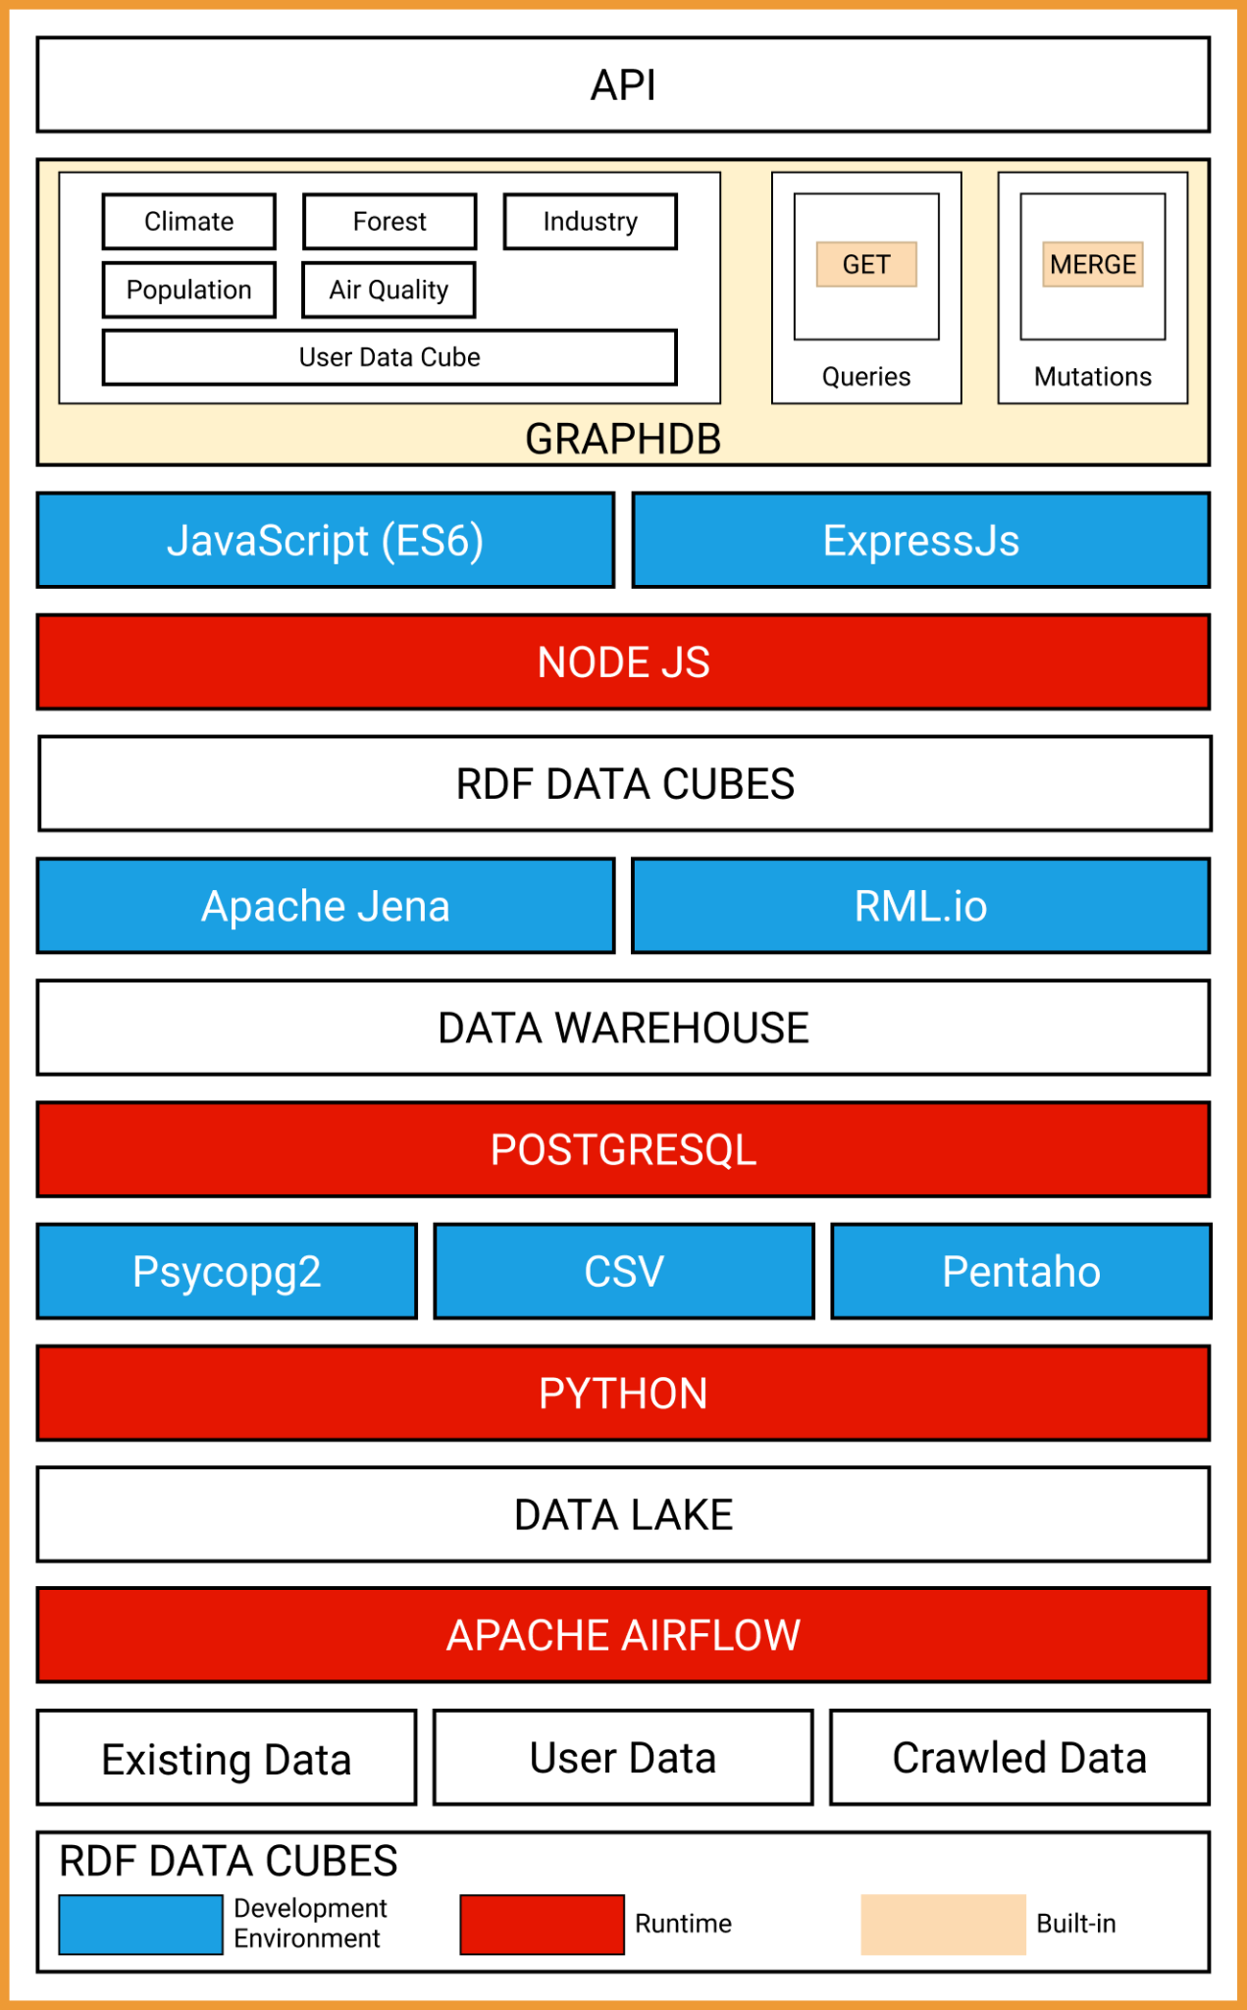
Table of contents
Main content:
1. Idea
2. Product
3. Technologies Stack
4. Project Management
5. Demo
6. Reflection
7. Summary
MODULE VIEW (SERVER)
Notes:
Hoa
Regarding the view module of the server, we can travel from bottom to top. First, after the data sources are collected and imported into the system, the apache airflow platform will take care of automating all the above processes like ETL data sources with Python libraries like Psycopg2, CSV and Pentaho.
Next, the cleaned data sets will be loaded into the data warehouse, which is built on the PostgreSQL database management system.
After the Data Warehouse has been completed, the datasets will be modeled and converted to RDF Data Cube based on Apache Jena technology and RML.io library.
The RDF Data Cubes will be loaded into the OntoText GraphDB federated database management system through APIs that facilitate communication between GraphDB and the server. In addition, the APIs also provide Get RDF Data Cubes and Merge Data Cubes methods for interacting with data on the client side.

Slide 26
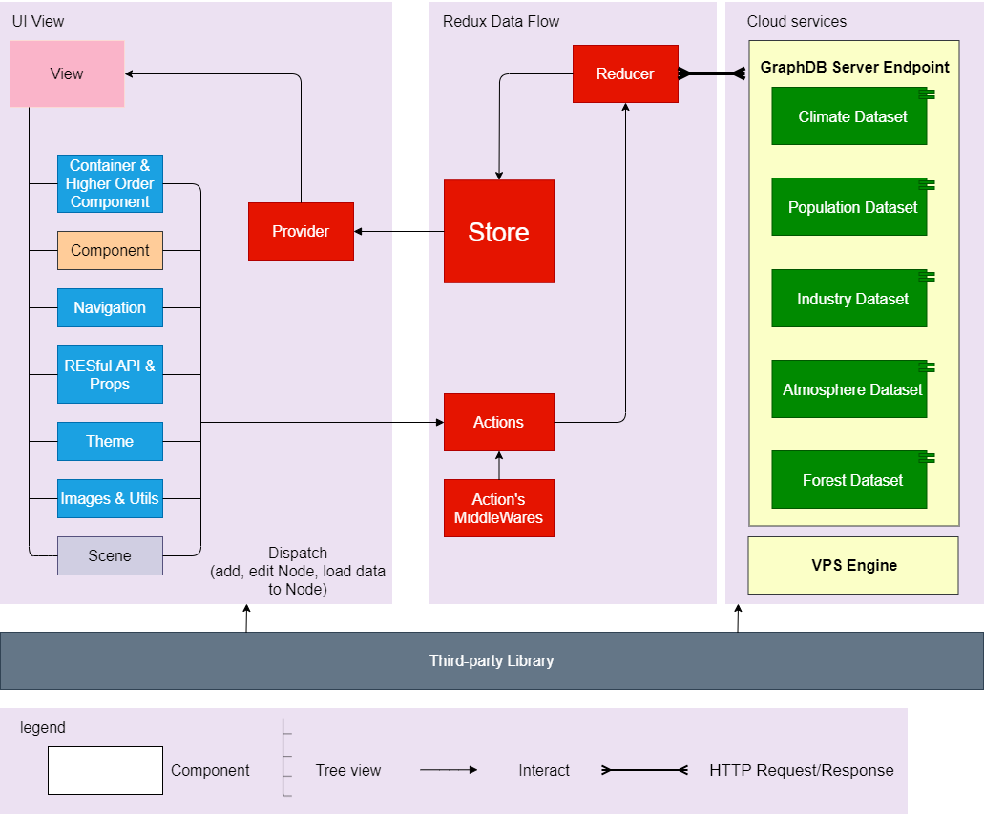
Table of contents
Main content:
1. Idea
2. Product
3. Technologies Stack
4. Project Management
5. Demo
6. Reflection
7. Summary
CLIENT SOLUTION (WEB APP) - COMPONENTS & CONNECTORS
Notes:
Tin
This is components & connectors diagram. Firstly, We use a VPS Engine to execute API between client & server. After that, we fetch data via RESTful API from server, and store data & state in Redux store. We use React for view DataCubes, Operators in users interface and use Highcharts library for visualise data in Charts, or in Maps
Deep into UI View
Web được dùng viết bằng React, và React đc viết theo kiểu chia nhỏ các components, nên để tiện cho việc quản lí state giữa các component, e đã dùng Redux, 1 thư viện chuyên để quản lý state. Và dùng VPS của Google để cho sử dụng call Rest API giữa client & server. Và dùng GraphDB để lưu dữ liệu. Cũng như thực hiện các câu lệnh query để lấy dữ liệu từ Data Cubes.

Slide 27
Technologies Stack
Which technologies are used ?
Notes:
kiều

Slide 28









Table of contents
Main content:
1. Idea
2. Product
3. Technologies Stack
4. Project Management
5. Demo
6. Reflection
7. Summary
PROGRAMMING LANGUAGE
SERVER-SIDE STACK
Javascript
PostgreSQL
… and more
Notes:
Use ExpressJS to build server & store data in GraphDB, Auto ETL with Apache Airflow, Auto RDF Data Cubes generator with RML.io & R2RML

Slide 29





Table of contents
Main content:
1. Idea
2. Product
3. Technologies Stack
4. Project Management
5. Demo
6. Reflection
7. Summary
PROGRAMMING LANGUAGE
CLIENT-SIDE STACK
Javascript
React
Redux
Material-UI
HighCharts
React Flow
Notes:
We use HighCharts for Visualise each datacube in Charts, Maps
In the next slide, we will talk about Project Management

Slide 30

Table of contents
Main content:
1. Idea
2. Product
3. Technologies Stack
4. Project Management
5. Demo
6. Reflection
7. Summary
CHALLENGES & FUTURE SCOPES
Challenges:
There are too many cases of messy data
Difficult to process all businesses within capstone's deadlines
Lack of support tools for automated process handling
The new UI is not optimized
Notes:
Tin
During the implementation of the project, we encountered many obstacles, such as:
- too many cases of messy data
- Difficult to process all businesses within capstone's deadlines
- Lack of support tools for automated process handling
- The new UI is not optimized
Although there are still many problems, we have managed to solve as many problems as possible

Slide 31

Table of contents
Main content:
1. Idea
2. Product
3. Technologies Stack
4. Project Management
5. Demo
6. Reflection
7. Summary
CHALLENGES & FUTURE SCOPES
Future scopes:
Improve the data ETL process, apply machine learning methods for better data cleaning
Build a desktop app that users can use without Internet
Provide query tool to help users perform data query right on UI
Notes:
Hoa
Mục tiêu trong tương lai, cụ thể là ở cap 2
Xây dựng công cụ cào dữ liệu tự động từ các report và các nguồn dữ liệu môi trường của các tổ chức phi chính phủ và chính phủ
Làm giàu nguồn dữ liệu nhằm xây dựng một cấu trúc hierarchy đầy đủ
Xây dựng phương pháp ml nhằm liên kết các khối dữ liệu một cách thông minh theo đúng nghĩa
Xây dựng một số tính năng phục vụ cho việc báo cáo khoa học của người dùng như lưu các report và các dashboard content dưới dạng pdf, image, và các giới thiệu cũng như thông tin bên lề về các mốc dữ liệu In the future, we will continue to develop this project, aiming to become a highly usable tool, not just for demo purposes.
We will improve the data ETL process, apply machine learning methods for better data cleaning
build a desktop app that users can use without being online
Provide query tool to help users perform data query right on UI

Slide 32
Project Management
Learn how we organize the project
Notes:
Dong

Slide 33

Table of contents
Main content:
1. Idea
2. Product
3. Technologies Stack
4. Project Management
5. Demo
6. Reflection
7. Summary
Our Process
Master Plan
Sprint I
Sprint II
Sprint III
Sprint IV
Sprint V
Sprint VI
Notes:
Dong

Slide 34
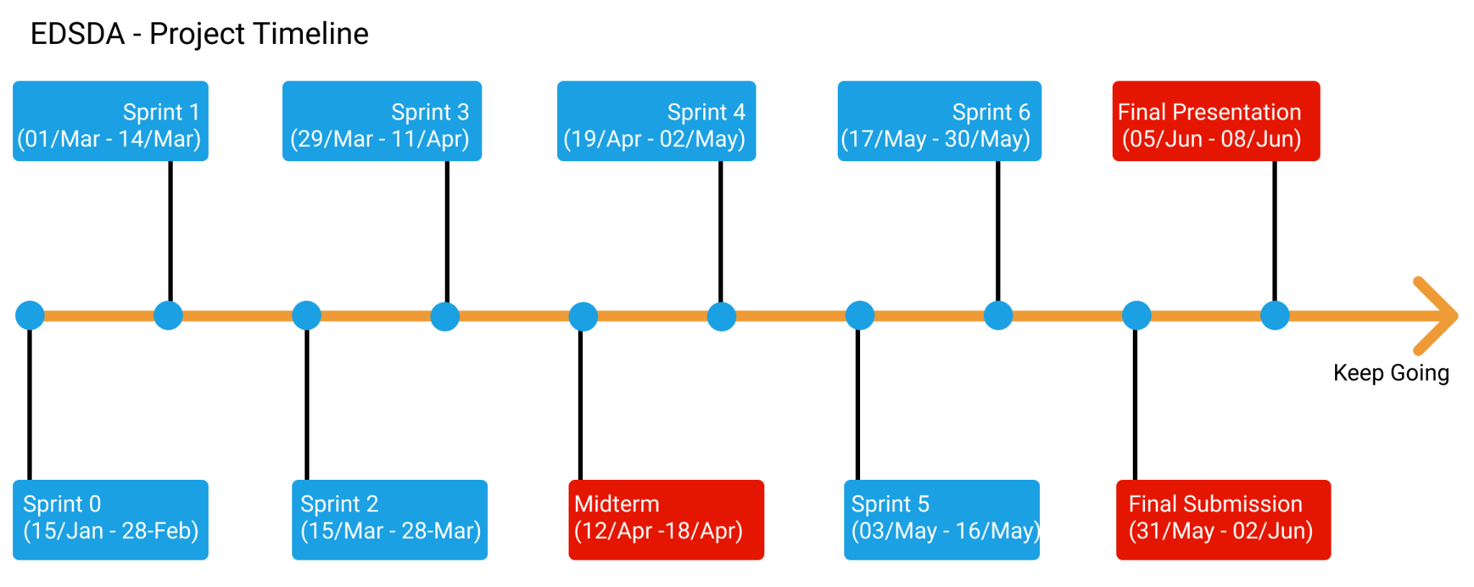
Table of contents
Main content:
1. Idea
2. Product
3. Technologies Stack
4. Project Management
5. Demo
6. Reflection
7. Summary
Notes:
Dong.
Our process is divide into 6 sprints, each sprint has 2 weeks for suitable with the short deadline.

Slide 35
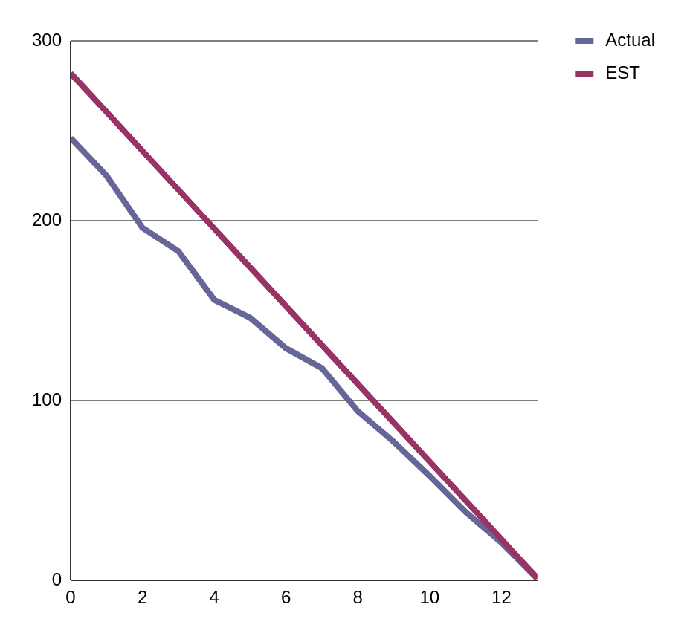
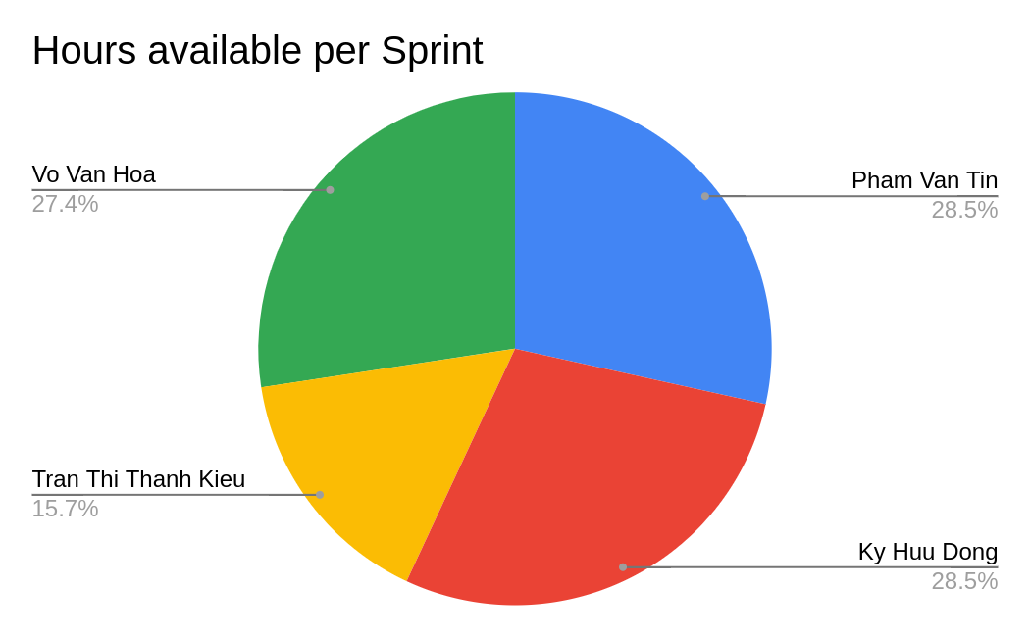
Sprint 1
Initiate project requirement & design
Estimate: 282 hours
Notes:
Dong
Everyone was doing well because we just did the basic components & configuration for the application, but sometime the milestone was delayed because of the difficulties in finding data sources

Slide 36
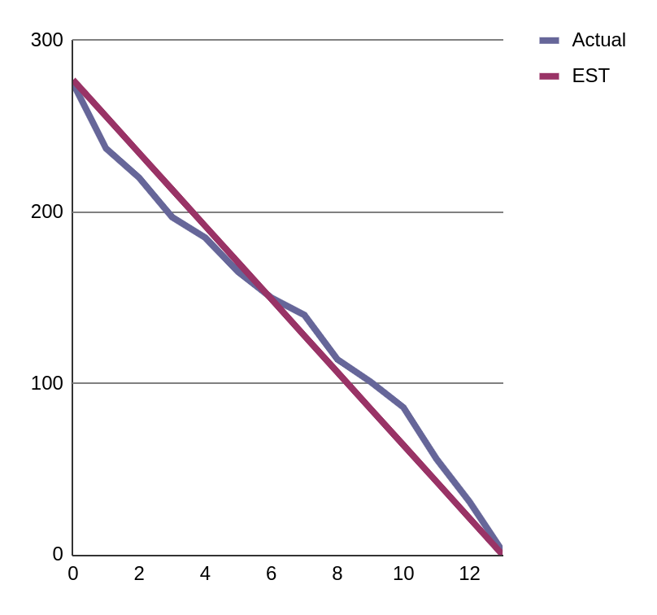
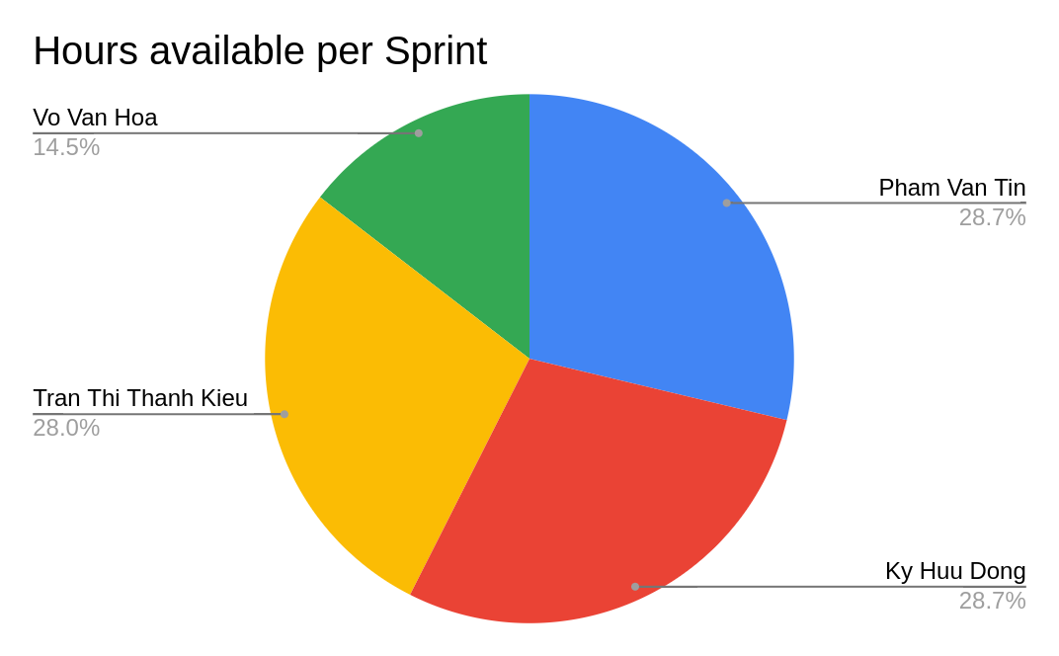
Sprint 2
Initiate infrastructure & data
Estimate: 277 hours
Notes:
Dong
in sprint 2, we faced some problems with support tools as well as working with new technology, so in the middle, the tasks progressed quite slowly.

Slide 37
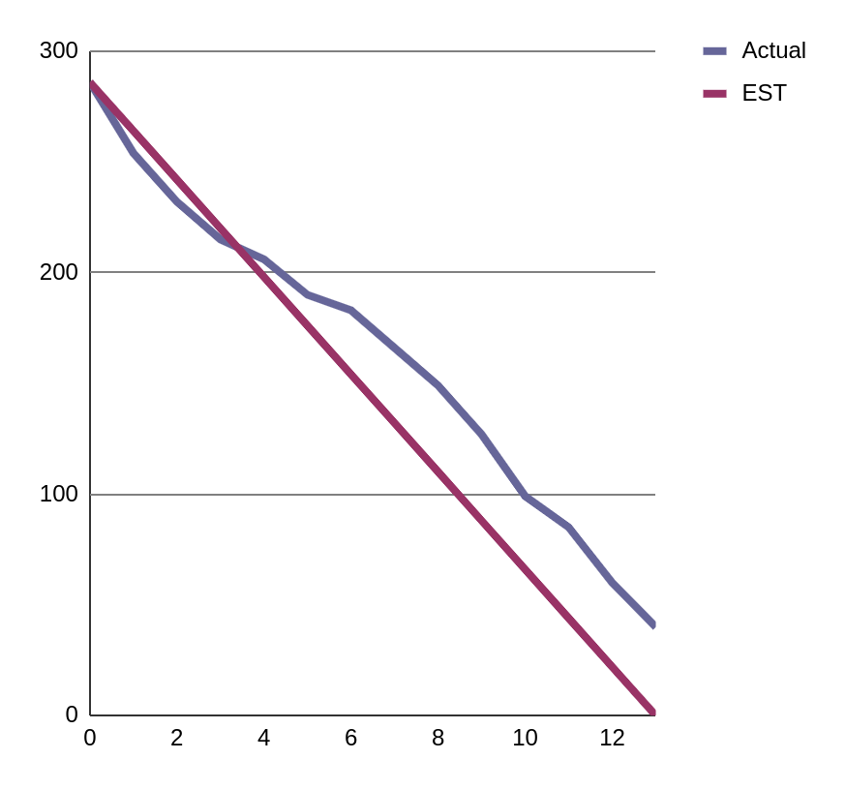
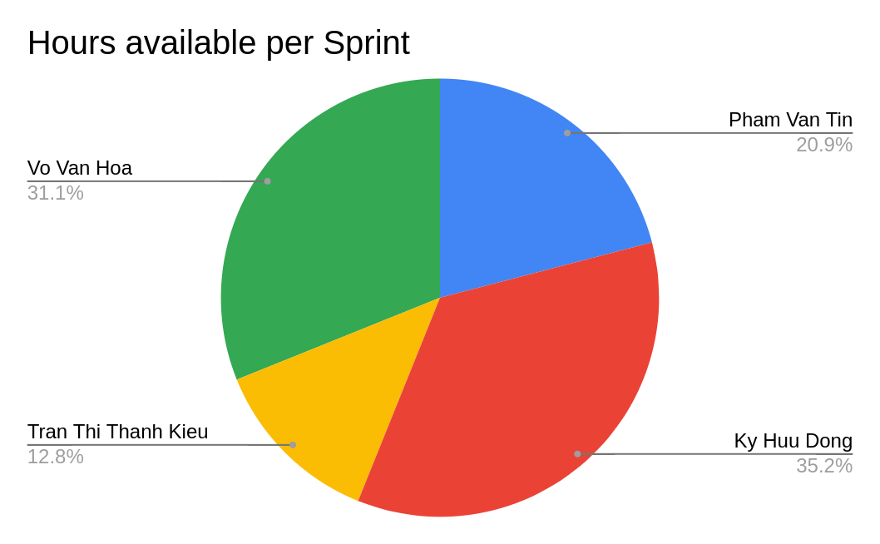
Sprint 3
Implement data processing methods
Estimate: 286 hours
Notes:
Dong
In sprint 3, we had to build core for automated data processing, it was a challenge for us, so we missed deadline and had to move some tasks to sprint 4

Slide 38
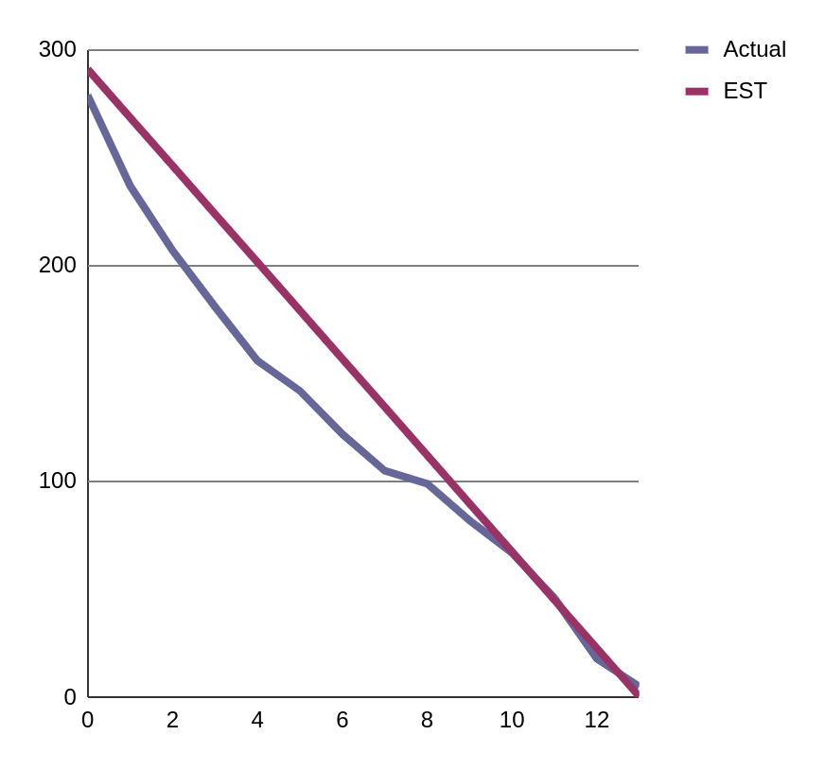
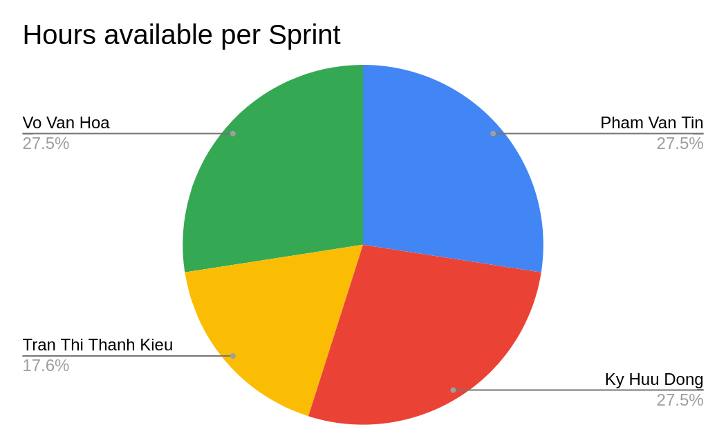
Sprint 4
Implement automatic methods
Estimate: 291 hours
Notes:
Dong
Since we have a better understanding of the system, even though there were some tasks left behind in sprint 3, we still caught up and completed it on time at sprint 4 và 5

Slide 39
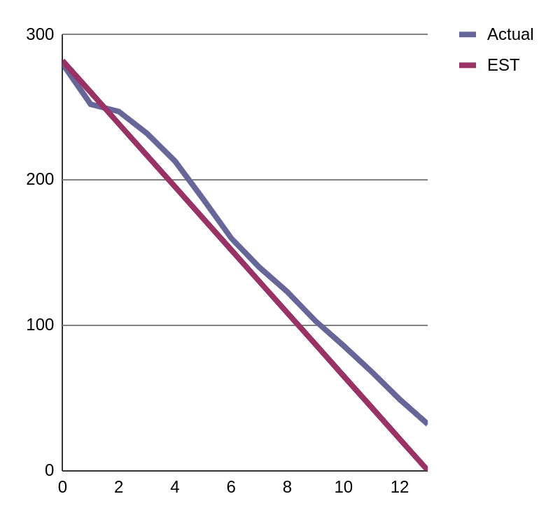
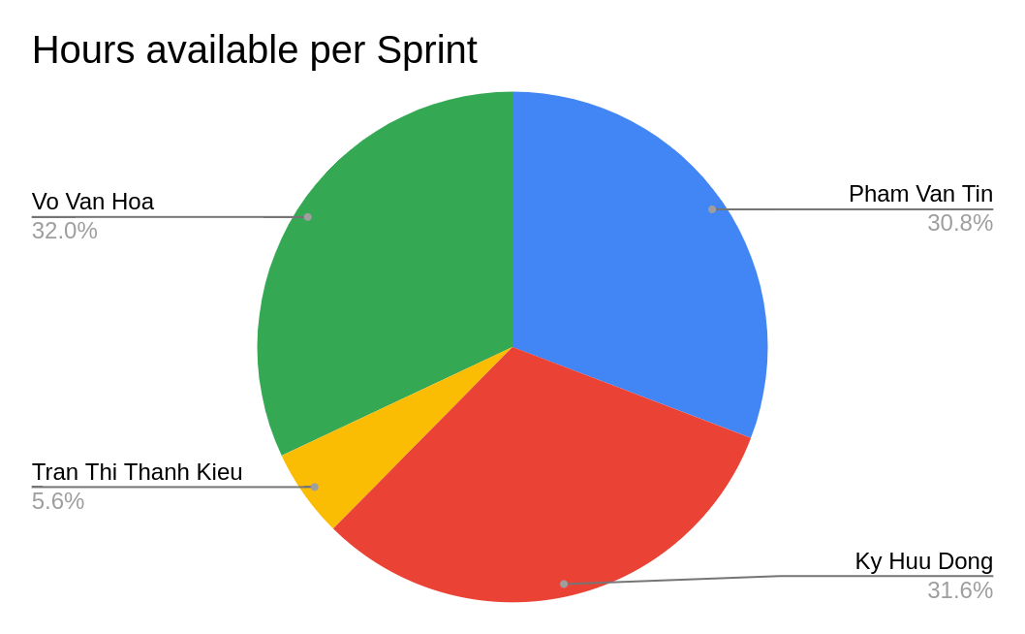
Sprint 5
Handle importing data sources
Estimate: 282 hours
Notes:
Dong
Everyone was doing well because we just did the basic components & configuration for the application, but sometime the milestone was delayed because of the difficulties in finding data sources

Slide 40
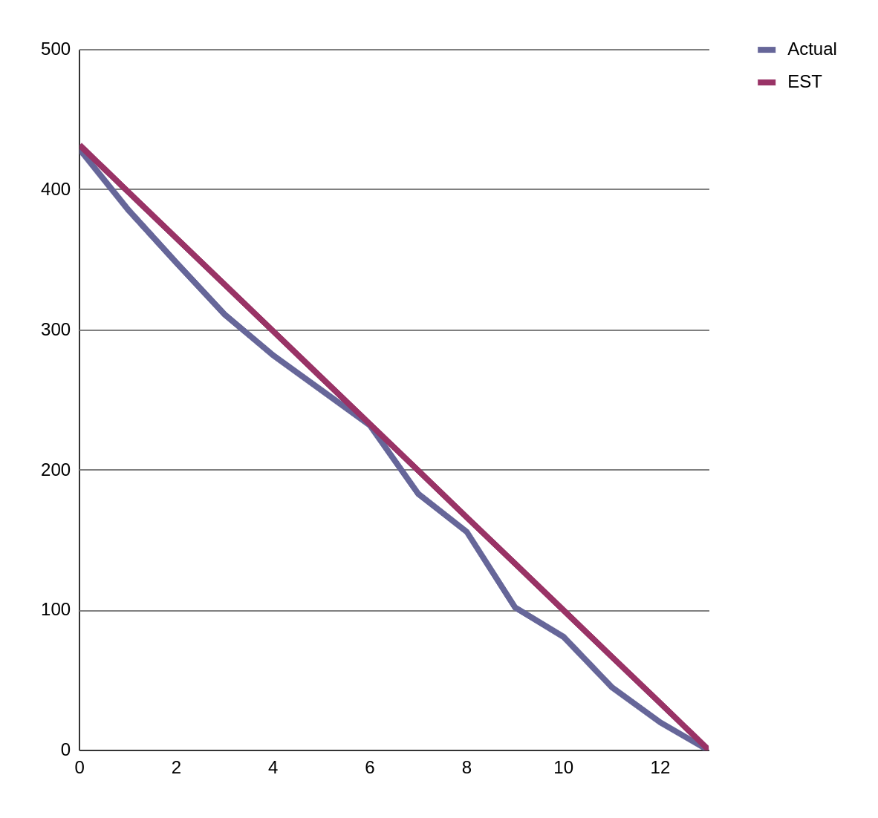
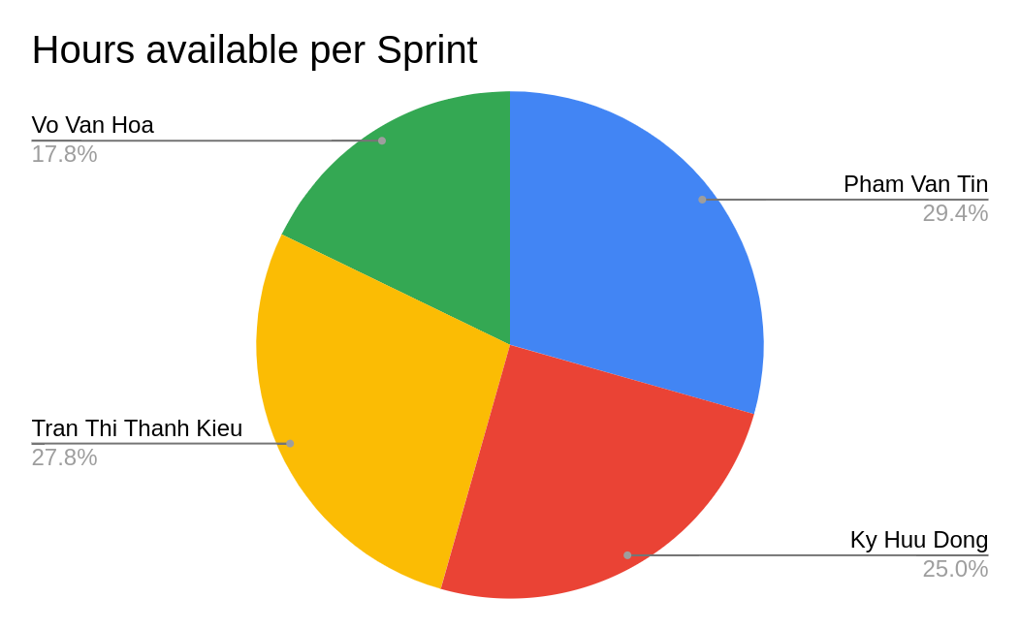
Sprint 6
Cloud server setting-up &
Product delivery
Estimate: 432 hours
Notes:
Dong
in the final stage, because we are used to deploying & integrate the system, so the progress is quite close to the expected time

Slide 41
Application Screenshot
How our application look like?
Notes:
Tin
And this is some screenshot of the application

Slide 42
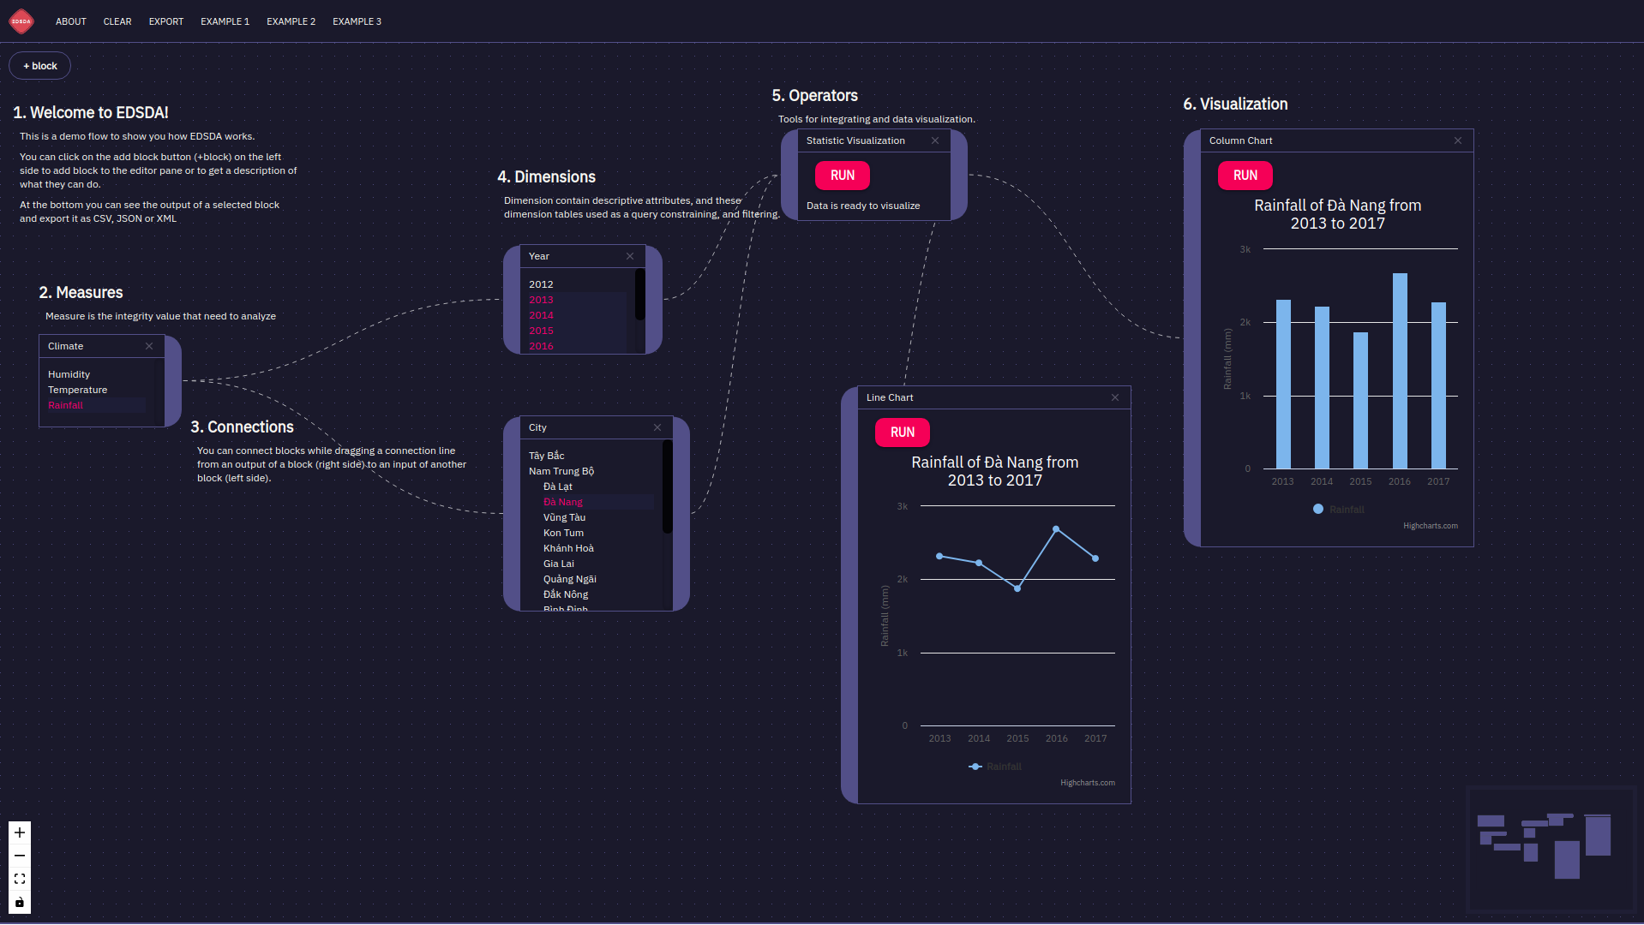
Application Screenshot
How our application look like?
Notes:
Tin

Slide 43
Demo
A live demo of our project
Notes:
Hoa, Tin.
Today’s demo, we will demo in 6 examples

Slide 44
Table of contents
Main content:
1. Idea
2. Product
3. Technologies Stack
4. Project Management
5. Demo
6. Reflection
7. Summary
Merge Rainfall and Forest Cover Area in Huyen Chiem Hoa from 2008 > 2015
Notes:
chon data cube climate: temperature, humidity, (rainfall)
hien thi year, city
goi y' merge: (forest cover), atmosphere
click: forestcover > open: data cube forest: (forestcover), afforestation
keo' 2 widgets vao chung city
chon district: (Huyện Chiêm Hóa)
keo' district qua year: render (2008 > 2015)
keo' year sang statisctic merge
keo' merge sang visualization
render: Line Chart, Column Chart
There was an environmental expert who wanted to find out the impact between rainfall and forest cover in Chiem Hoa district, Tuyen Quang province, where deforestation is common in Northwest Vietnam.
To do this, he goes to EDSDA's available data cubes library and selects data cube climate, which contains data about measure rainfall, and selects region -> province -> Chiem Hoa district, then the system will suggests mergeable data cubes, including forest data cubes. The forest coverage area data is located in the data cube forest, so the user will select the data cube forest and the forest widget will jump to the dashboard. Once the data cubes are ready, we proceed to connect them to the common dimensions. After completing the data preparation steps, the user will choose operator Statistic merge to merge the 2 data sets, and then operator visualization to prepare the data visualization operation.
The final step is to drag the multi axis chart to the dashboard to visualize the newly merged data cube from the 2 datasets. As we can see, looking at the newly created chart, users can assess the impact of forest cover on rainfall and make appropriate judgments.

Slide 45
Table of contents
Main content:
1. Idea
2. Product
3. Technologies Stack
4. Project Management
5. Demo
6. Reflection
7. Summary
Visualize messy CSV file of Rice’s production of Vietnam from 1995 to 2019
Notes:
click add block > Import
open Import modal
import file: sanluonglua.csv > review data 3 steps
if import san luong lua = true > display san luong lua in Available Data Cubes
onAddWidget san luong lua on EditorPane
Widget: San luong lua: Year 1995 > 2018
Select 2018
connect sang statistic viz
statistic viz connect sang Maps
viz on Maps
Choose range for filter
Export PDF
Let's suppose we have a csv file with a heterogeneous structure of the country's rice production from 1995 to 2019 and want an overview of the country's rice production in 2018, I will upload it up by file in toolbox
after uploading the csv file and etl process takes place, the system will allow me to review the normalized data, then the system will automatically suggest the columns that can be used for measure and dimension.
finally, after the dimensions and measures for the rice yield data block have been defined, it will be stored in avalable data cubes.
To use, we will select the rice yield data cube. When the widget appears, we proceed to select the year 2018 in the dimension year and then select operator statistic merge. In this example I will choose to visualize 2018 rice production in the form of maps.
The map will show the rice production of the provinces corresponding to each color, we can use the filter tool to filter out the provinces with the average, the lowest and the largest rice production.
To save the map of rice production for report generation, we just need to zoom in on the map and then click on the export function, the chart map will automatically be downloaded to the user's device.

Slide 46
Table of contents
Main content:
1. Idea
2. Product
3. Technologies Stack
4. Project Management
5. Demo
6. Reflection
7. Summary
Import Die young CSV file and then
Merge with Industry Index
From 2012 to 2018 to visualize
Notes:
click add block > Import
open Import modal
import file: dieYoung.json > review data 3 steps
display dieYoung in Toolbox
chon data cube DieYoung: (DieYoung)
hien thi year, city
goi y' merge: (Industry), Temperature
click: industry > open: data cube forest: (Industry)
keo' 2 widgets vao chung city
chon district: Dong Bang Song Hong
keo' district qua year: render (2012 to 2018)
keo' year sang statistic merge
keo' merge sang visualization
render: Multi Axes Chart
Thanks to sparql technology, a newly imported data cube can also be merged with a pre-existing data cube .
for example, we have a csv file about the infant mortality rate in Vietnam from year x to year y, we perform import file operations on the system like the previous examples.
After the import is done, we merge and visualize the data as 2 existing data cubes of the data.
As we can see, the correlation between the two data subjects will be easily evaluated through the chart.
Although industrial development leads to more waste, industry also helps people's economy become better off, thereby reducing the rate of child deaths due to more adequate medical care.

Slide 47
Team Reflection
What we had learn?

Slide 48

Table of contents
Main content:
1. Idea
2. Product
3. Technologies Stack
4. Project Management
5. Demo
6. Reflection
7. Summary
DISADVANTAGES
Notes:
- Khó khăn gặp phải:
because of covid-19, and everyone’s schedule in the team is different. So almost all the team meeting are online discussion

Slide 49

Table of contents
Main content:
1. Idea
2. Product
3. Technologies Stack
4. Project Management
5. Demo
6. Reflection
7. Summary
<NewTechnologies
researching
dataCube
dataVisualization
/>
TEAMWORK
IMPROVE SKILLS
CODING LIKE PRO
HAVE GREAT TIME TOGETHER!
Notes:
Advantage

Slide 50
Summary
Notes:
Kieu

Slide 51
Table of contents
Main content:
1. Idea
2. Product
3. Technologies Stack
4. Project Management
5. Demo
6. Reflection
7. Summary
Hoa, Vo Van
Tasks:
Back-end Dev
RDF Data Cubes Developer
Tin, Pham Van
Tasks:
UI/UX Designer
Front-end Developer
Dong, Ky Huu
Tasks:
Database Developer
Tester
Kieu, Tran Thi Thanh
Tasks:
Front-end Developer
Tester
Notes:
Kieu
-tasks:
==>Everyone has completed the tasks.

Slide 52
Thank you very much
for NOT falling asleep!
If you have any questions about this document
please don’t hesitate to contact us at:
https://sda-research.ml/
https://github.com/sdateamdtu2020/SDA-v2.0
sdadevteamdtu@gmail.com

